Slide 1
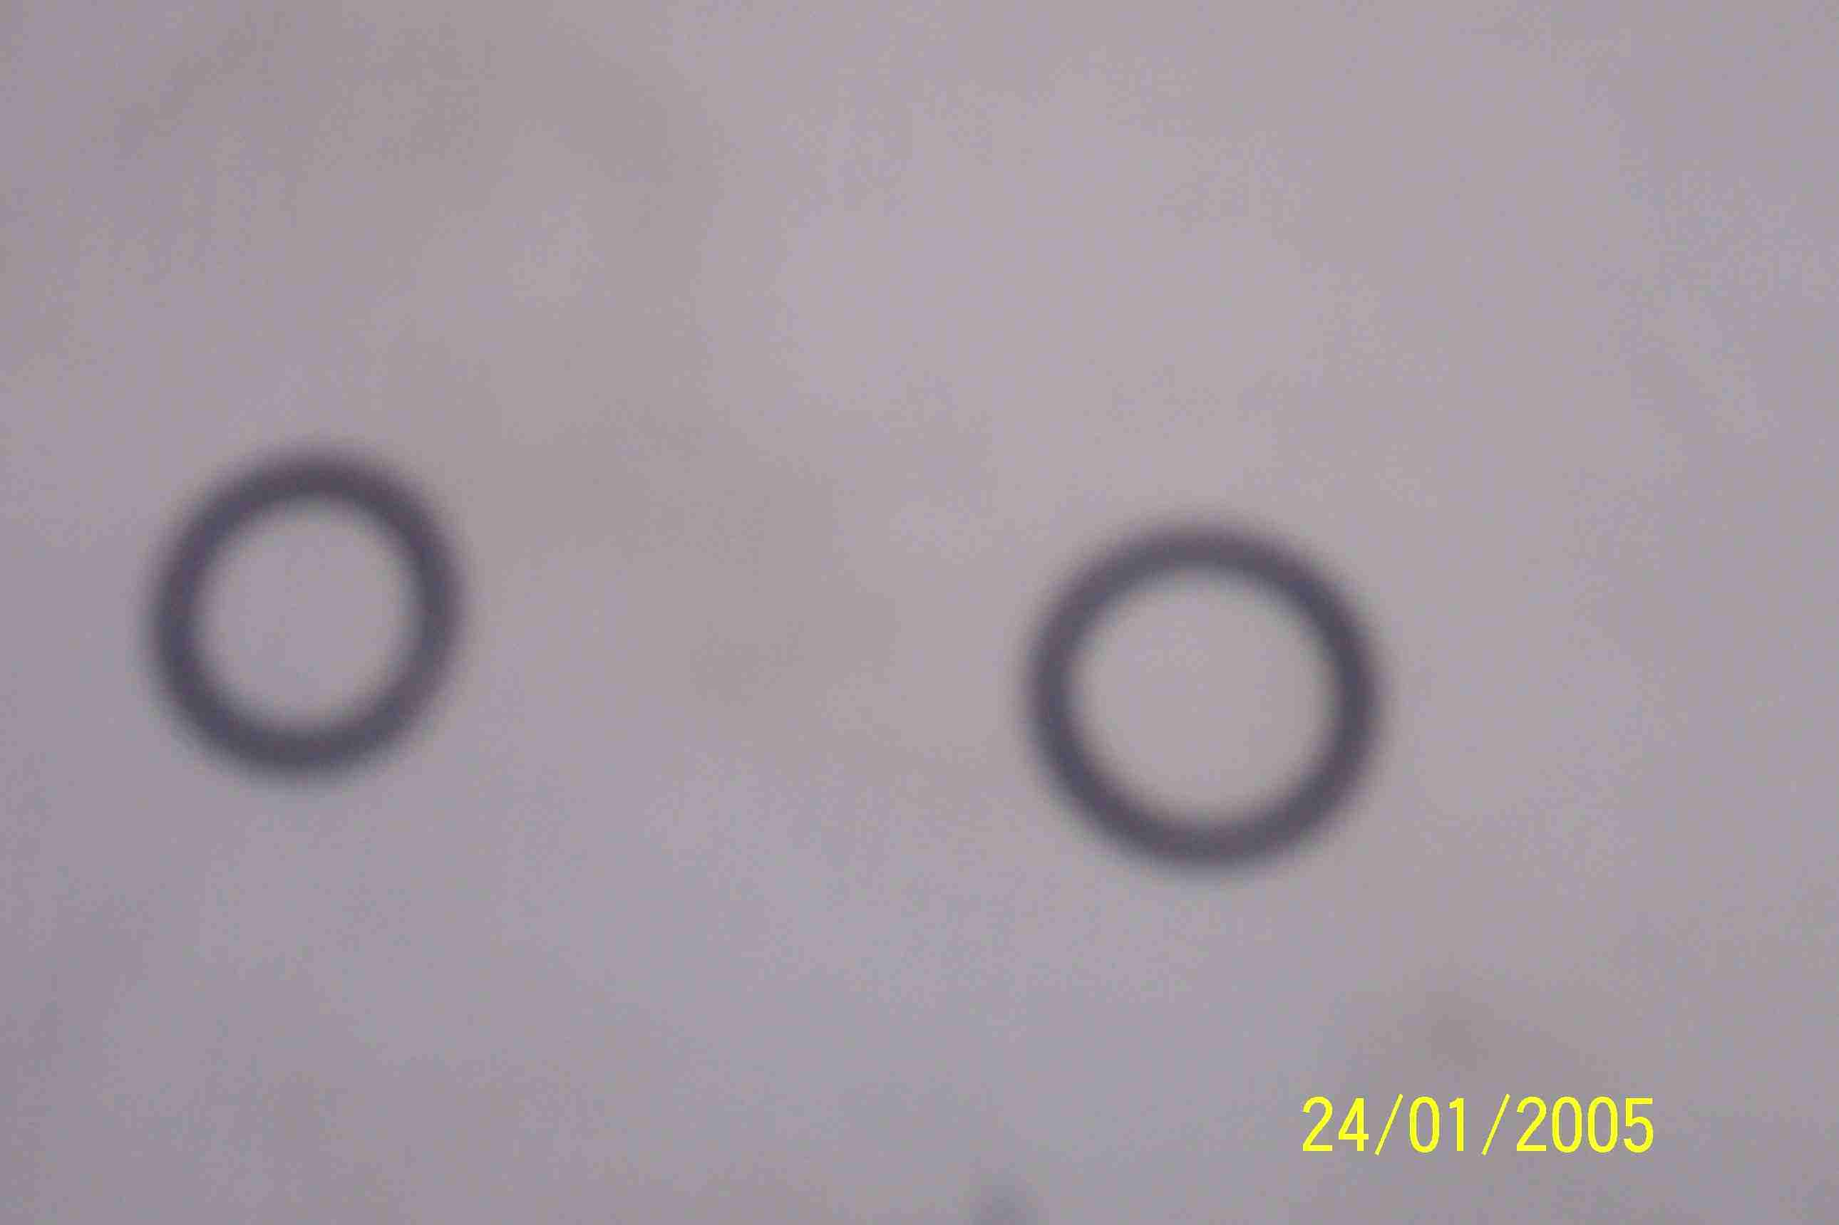
SIEMENS
HVCB SPARES
O rings for SF6 pipe 12.8 size
For 72.5KV, 145KV & 245KV CB
S4951312000
O rings for SF6 pipe 14.0 size
For 72.5KV, 145KV & 245KV CB
S4947804001

